Slide 1
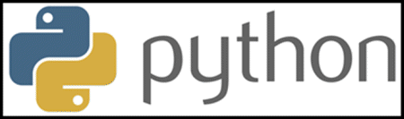
Yerram sneha

Slide 2
What is Python
Python is a general purpose, dynamic, high-level, and interpreted programming language. It supports Object Oriented programming approach to develop applications. It is simple and easy to learn and provides lots of high-level data structures.
Python is easy to learn yet powerful and versatile scripting language, which makes it attractive for Application Development.
Python's syntax and dynamic typing with its interpreted nature make it an ideal language for scripting and rapid application development.
Python supports multiple programming pattern, including object-oriented, imperative, and functional or procedural programming styles.
Python is not intended to work in a particular area, such as web programming. That is why it is known as multipurpose programming language because it can be used with web, enterprise, 3D CAD, etc.
We don't need to use data types to declare variable because it is dynamically typed so we can write a=10 to assign an integer value in an integer variable.
Python makes the development and debugging fast because there is no compilation step included in Python development, and edit-test-debug cycle is very fast.

Slide 3
Python 2 vs. Python 3
A list of differences between Python 2 and Python 3 are given below:
Python 2 uses print as a statement and used as print "something" to print some string on the console. On the other hand, Python 3 uses print as a function and used as print("something") to print something on the console.
Python 2 uses the function raw_input() to accept the user's input. It returns the string representing the value, which is typed by the user. To convert it into the integer, we need to use the int() function in Python. On the other hand, Python 3 uses input() function which automatically interpreted the type of input entered by the user. However, we can cast this value to any type by using primitive functions (int(), str(), etc.).
In Python 2, the implicit string type is ASCII, whereas, in Python 3, the implicit string type is Unicode.
Python 3 doesn't contain the xrange() function of Python 2. The xrange() is the variant of range() function which returns a xrange object that works similar to Java iterator. The range() returns a list for example the function range(0,3) contains 0, 1, 2
There is also a small change made in Exception handling in Python 3. It defines a keyword as which is necessary to be used. We will discuss it in Exception handling section of Python programming tutorial.

Slide 4
Python History
Python was invented by Guido van Rossum in 1991 at CWI in Netherland. The idea of Python programming language has taken from the ABC programming language or we can say that ABC is a predecessor of Python language.
There is also a fact behind the choosing name Python. Guido van Rossum was a fan of the popular BBC comedy show of that time, "Monty Python's Flying Circus". So he decided to pick the name Python for his newly created programming language.
Python has the vast community across the world and releases its version within the short period.

Slide 5
Python Version | Released Date
Python 1.0 | January 1994
Python 1.5 | December 31, 1997
Python 1.6 | September 5, 2000
Python 2.0 | October 16, 2000
Python 2.1 | April 17, 2001
Python 2.2 | December 21, 2001
Python 2.3 | July 29, 2003
Python 2.4 | November 30, 2004
Python 2.5 | September 19, 2006
Python 2.6 | October 1, 2008
Python 2.7 | July 3, 2010
Python 3.0 | December 3, 2008
Python 3.1 | June 27, 2009
Python 3.2 | February 20, 2011
Python 3.3 | September 29, 2012
Python 3.4 | March 16, 2014
Python 3.5 | September 13, 2015
Python 3.6 | December 23, 2016
Python 3.7 | June 27, 2018
Python 3.8 | October 14, 2019
Python Version List

Slide 6
Python Features
1) Easy to Learn and Use
7) Extensible
8) Large Standard Library
2) Expressive Language
9) GUI Programming Support
3) Interpreted Language
10) Integrated
4) Cross-platform Language
11. Embeddable
5) Free and Open Source
12. Dynamic Memory Allocation
6) Object-Oriented Language

Slide 7
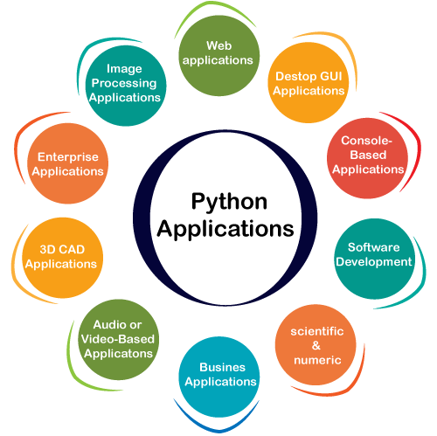

Slide 8
Python First Program
Unlike the other programming languages, Python provides the facility to execute the code using few lines. For example - Suppose we want to print the "Hello World" program in Java; it will take three lines to print it.
public class HelloWorld {
public static void main(String[] args){
// Prints "Hello, World" to the terminal window.
System.out.println("Hello World");
}
}
On the other hand, we can do this using one statement in Python.
print("Hello World")
Both programs will print the same result, but it takes only one statement without using a semicolon or curly braces in Python.
Python Basic Syntax
There is no use of curly braces or semicolon in Python programming language. It is English-like language. But Python uses the indentation to define a block of code. Indentation is nothing but adding whitespace before the statement when it is needed. For example -
def func():
statement 1
statement 2
…………………
…………………
statement N

Slide 9
Python print() Function
The print() function displays the given object to the standard output device (screen) or to the text stream file.
Unlike the other programming languages, Python print() function is most unique and versatile function.
The syntax of print() function is given below.
print(*objects, sep=' ', end='\n', file=sys.stdout, flush=False)
Let's explain its parameters one by one.
objects - An object is nothing but a statement that to be printed. The * sign represents that there can be multiple statements.
sep - The sep parameter separates the print values. Default values is ' '.
end - The end is printed at last in the statement.
file - It must be an object with a write(string) method.
flush - The stream or file is forcibly flushed if it is true. By default, its value is false.

Slide 10
Taking Input to the User
Python provides the input() function which is used to take input from the user. Let's understand the following example.
Example -
name = input("Enter a name of student:")
print("The student name is: ", name)
Example - 1: Return a value
print("Welcome to javaTpoint.")
a = 10
# Two objects are passed in print() function
print("a =", a)
b = a
# Three objects are passed in print function
print('a =', a, '= b')
By default, the input() function takes the string input but what if we want to take other data types as an input.
If we want to take input as an integer number, we need to typecast the input() function into an integer.
For example -
Example -
a = int(input("Enter first number: "))
b = int(input("Enter second number: "))
print(a+b)
Example - 2: Using sep and end argument
a = 10
print("a =", a, sep='dddd', end='\n\n\n')
print("a =", a, sep='0', end='$$$$$')

Slide 11
Identifier Naming
Variables are the example of identifiers. An Identifier is used to identify the literals used in the program. The rules to name an identifier are given below.
The first character of the variable must be an alphabet or underscore ( _ ).
All the characters except the first character may be an alphabet of lower-case(a-z), upper-case (A-Z), underscore, or digit (0-9).
Identifier name must not contain any white-space, or special character (!, @, #, %, ^, &, *).
Identifier name must not be similar to any keyword defined in the language.
Identifier names are case sensitive; for example, my name, and MyName is not the same.
Examples of valid identifiers: a123, _n, n_9, etc.
Examples of invalid identifiers: 1a, n%4, n 9, etc.
Python Variables
Variable is a name that is used to refer to memory location. Python variable is also known as an identifier and used to hold value.
In Python, we don't need to specify the type of variable because Python is a infer language and smart enough to get variable type.
Variable names can be a group of both the letters and digits, but they have to begin with a letter or an underscore.
It is recommended to use lowercase letters for the variable name. Rahul and rahul both are two different variables.

Slide 12

Declaring Variable and Assigning Values
Python does not bind us to declare a variable before using it in the application. It allows us to create a variable at the required time.
We don't need to declare explicitly variable in Python. When we assign any value to the variable, that variable is declared automatically.
The equal (=) operator is used to assign value to a variable.
Object References
It is necessary to understand how the Python interpreter works when we declare a variable. The process of treating variables is somewhat different from many other programming languages.
Python is the highly object-oriented programming language; that's why every data item belongs to a specific type of class. Consider the following example.
print("John")
type("John")

Slide 13

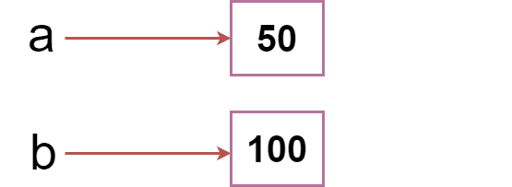

Slide 14
Object Identity
In Python, every created object identifies uniquely in Python. Python provides the guaranteed that no two objects will have the same identifier. The built-in id() function, is used to identify the object identifier. Consider the following example.
a = 50
b = a
print(id(a))
print(id(b))
# Reassigned variable a
a = 500
print(id(a))
Variable Names
We have already discussed how to declare the valid variable. Variable names can be any length can have uppercase, lowercase (A to Z, a to z), the digit (0-9), and underscore character(_). Consider the following example of valid variables names.
name = "Devansh"
age = 20
marks = 80.50
print(name)
print(age)
print(marks)

Slide 15
Multiple Assignment
Python allows us to assign a value to multiple variables in a single statement, which is also known as multiple assignments.
We can apply multiple assignments in two ways, either by assigning a single value to multiple variables or assigning multiple values to multiple variables. Consider the following example.
1. Assigning single value to multiple variables
Eg:
x=y=z=50
print(x)
print(y)
print(z)
2. Assigning multiple values to multiple variables:
Eg:
a,b,c=5,10,15
print a
print b
print c

Slide 16
Python Variable Types
There are two types of variables in Python - Local variable and Global variable. Let's understand the following variables.
Local Variable
Local variables are the variables that declared inside the function and have scope within the function. Let's understand the following example.
Example -
# Declaring a function
def add():
# Defining local variables. They has scope only within a function
a = 20
b = 30
c = a + b
print("The sum is:", c)
# Calling a function
add()
Global Variables
Global variables can be used throughout the program, and its scope is in the entire program. We can use global variables inside or outside the function.
A variable declared outside the function is the global variable by default. Python provides the global keyword to use global variable inside the function. If we don't use the global keyword, the function treats it as a local variable. Let's understand the following example.
Example -
# Declare a variable and initialize it
x = 101
# Global variable in function
def mainFunction():
# printing a global variable
global x
print(x)
# modifying a global variable
x = 'Welcome To Javatpoint'
print(x)
mainFunction()
print(x)

Slide 17


